Slide 1
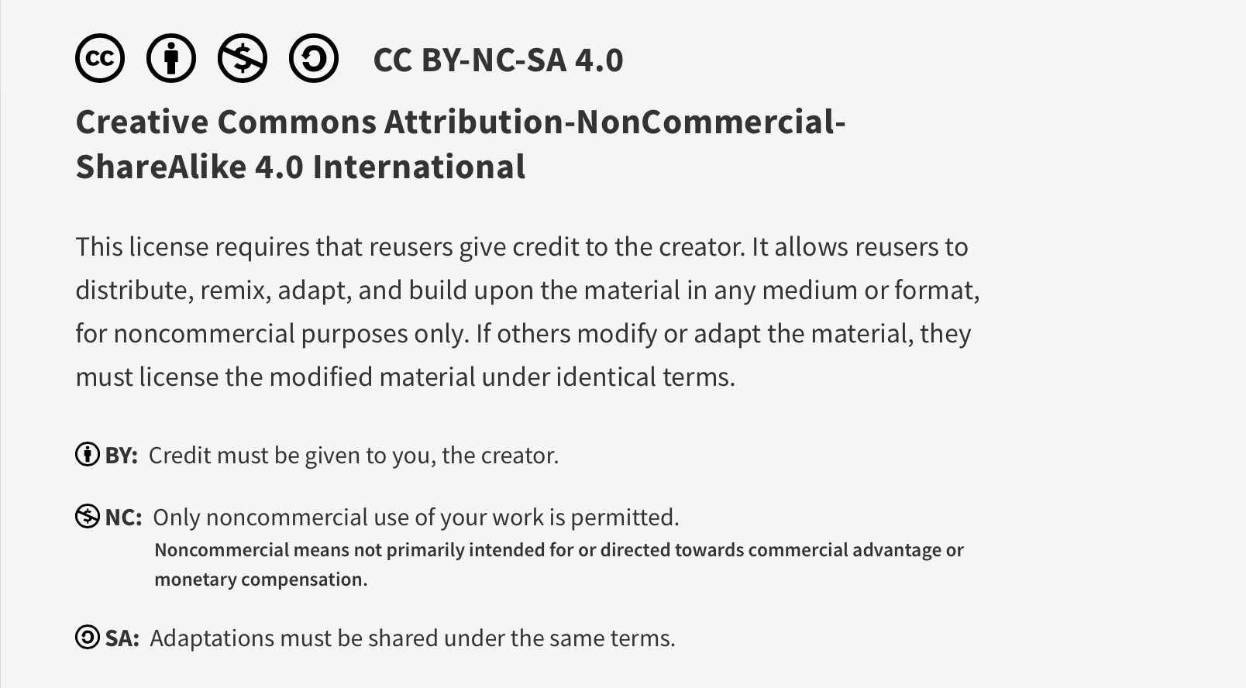
This work is licensed under CC BY-NC-SA 4.0. To view a copy of this license, visit: https://creativecommons.org/licenses/by-nc-sa/4.0/

Slide 2

Human Factors and Human Limitations Pre-Session Material
Lucie Filteau, MD, FRCPC
PGY 2-4 Academic half day
QPS Series

Slide 3
Objectives
To become familiar with the field of human factors (HF) and the impact of it on patient safety
To be able to recognize and report human factors issues encountered in our daily work life
To acknowledge our personal limitations that can impact performance and safety
Will focus on HF in equipment design and cognitive biases

Slide 4
“Dependencies on perfect human performance to ensure patient safety are both scientifically and practically unreliable. Humans err.”
Joseph Cafazzo, Healthcare Quarterly, 2012
Healthcare Quarterly 15 (Special Issue) April 2012: 24-29.doi:10.12927/hcq.2012.22845

Slide 5
Factors Limiting Human Performance
External factors
Distractions
Cognitive overload (multitasking, excessive workload)
Time pressures
Physical environment (temp, lighting, physical layout)
Equipment/technology* (user interface)
Internal
Cognitive bias
Emotion
Fatigue
*Technology can free up or tax cognitive processes
Notes:
Will focus on highlighted content.

Slide 6
Human Factors – Official Definition
”The scientific discipline concerned with the understanding of interactions among humans and other elements of a system, and the profession that applies theory, principles, data, and other methods to design in order to optimize human well-being and overall system performance.”
International Ergonomics Association, 2000 (https://iea.cc/about/what-is-ergonomics/)

Slide 7
Human Factors – Wiki Definition
“The application of psychological and physiological principles to the engineering and design of products, processes and systems (with a specific focus on the interaction between the human and the thing of interest). The main goals are to:
reduce human error
increase productivity
enhance safety
enhance comfort

Slide 8
“We cannot change the human condition but we can change the conditions under which humans work”
James Reason, 1999
Important: HF practitioners aren’t trying to change the clinicians’ limitations, just study them, take them into account and design accordingly
https://www.ncbi.nlm.nih.gov/pmc/articles/PMC1070929/pdf/wjm17200393.pdf

Slide 9
Human Factors – Disciplines Involved
Psychology
Sociology
Engineering
Biomechanics
Industrial design
Visual design
User experience
User interface design

Slide 10
Some Methods of Study
User analysis (ideally pre-design)
Observation (Ethnography or Simulation)
Focus groups, surveys
Performance modelling
Time studies
Iterative design
Cognitive walk through
Task analysis
Ergonomic evaluation

Slide 11
Examples of Equipment Design Elements
Physical (weight, size)
Psychological (intuitive menus)
Ergonomic (height/tilt adjustment)
Auditory (alarms tone, volume)
Software (default settings)
Safety features (alarm types and limit settings)

Slide 12
Ways Technology Can Improve Safety
Smart pumps
Automated dispensing cabinets
Clinical decision support software
Elimination of handwriting
Improved access to records
Cognitive load reduction with automated tasks

Slide 13
Ways Technology Can Compromise Safety
Poor design
Poor implementation
Poor integration into workflows
Lack of maturity of technology
Lack of compliance with standards
Lack of equipment standardization
Over-reliance on technology

Slide 14

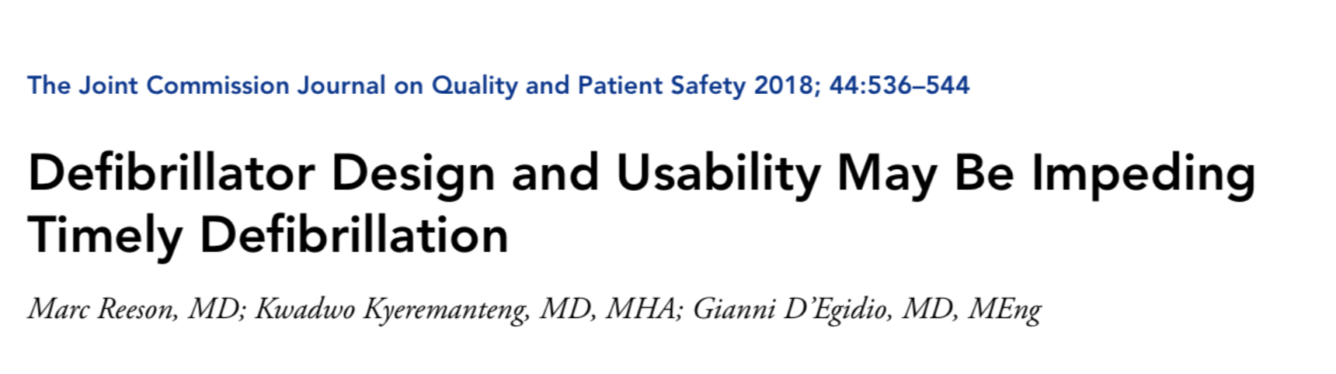



Example of Human Factors Research

Slide 15
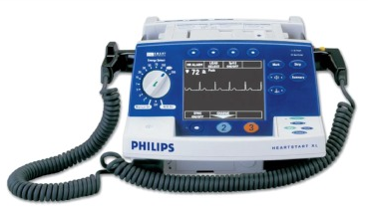
The Ottawa Hospital (TOH) Study
Timely defib is the only therapy proven to increase survival to hospital discharge
AHA Guidelines recommend defib within 2 minutes of recognition of in-hospital arrest
Average time to defibrillation at TOH
Acute Care (ED/ICU/PACU): 8 mins
Ward: 11 mins
https://doi.org/10.1016/j.jcjq.2018.01.005

Slide 16
TOH HF Study
High fidelity usability testing in simulation lab
22 Internal Medicine residents (PGY 1-3)
ACLS trained within past 12 months
Two tasks: synchronized cardioversion and defib
Avg time to defib: 4 min 21 secs (only 9% did it within recommended 2 mins)
Avg time to synch cardiovert: 1 min, 55 secs

Slide 17
Results: Objective Observer Evaluations
Core Function | Participants with Difficulty Completing Task (%)
Ability to turn on defibrillator | 27.3
Ability to attach the defibrillator pads | 77.3
Ability to select an appropriate display | 54.5
Ability to deliver a defibrillation | 4.5
Ability to deliver a synchronized cardioversion | 13.6

Slide 18
Results: Objective Observer Evaluations
Subfunction: Attaching the Pads | Participants with Difficulty Completing Task (%)
Ability to identify the electrode pads | 17.6
Ability to identify the adaptor cable | 88.2
Ability to toggle the cable locking mechanism | 82.4
Ability to attach the electrode pads to the skin | 0

Slide 19
Subjective Usability Data
Reported difficulty with attaching pads was consistent with observations
Descriptors used: awkward, unintuitive, inconvenient
Overall usability score = 4.2/10
Conclusion: delay in defibrillation are at least partially due to poor defibrillator design and poor usability (Philips HeartStart XL)
Specifically attaching hands free pads and needing to manually select correct display

Slide 20
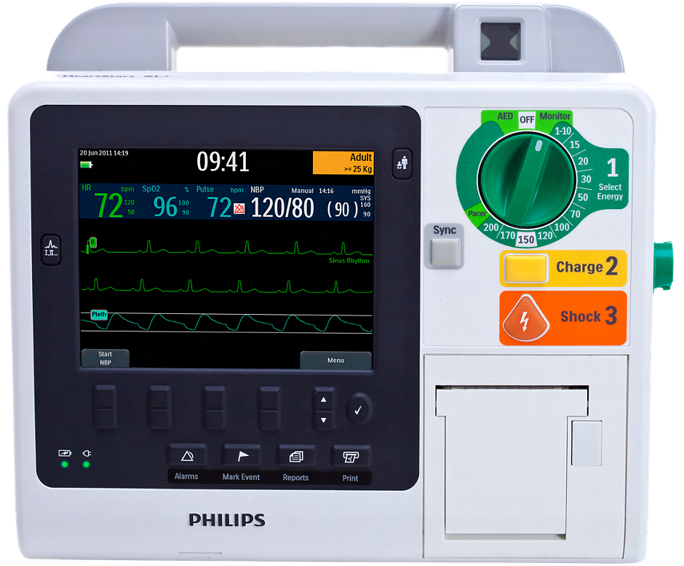
Recommendations
Future engineering
To produce hands free defib pads + cable as a single unit
To relocate the cable locking mechanism to a more accessible location
To modify the default display

Slide 21
More Recent Example: HF and COVID (PPE)
Various studies looking at impact of PPE (goggles/visor, mask, gown, gloves)
Fit comfort (heat, pressure points)
Ability to read and operate equipment (glare, fog)
Ability to hear and communicate
Ability to reach and move
Dexterity

Slide 22
Hospital Procurement of Technology
In past
Bias from vendor relationship
Mainly driven by cost
Lack of frontline involvement
Lack of local usability testing, trial period
Equipment lacks customization for local needs
This is gradually getting better…
Introduction of standard equipment trial protocols prior to contracts being awarded

Slide 23
Internal Human Limitations: Common Cognitive Biases in Medicine

Slide 24

Common Examples of Cognitive Biases in Medicine (NB: can have > 1 bias at a time!)
Anchoring
Premature closure
Zebra retreat
Search satisfaction
Bandwagon effect
Attribution error
Authority bias
Availability heuristic
https://www.cmpa-acpm.ca/serve/docs/ela/goodpracticesguide/pages/human_factors/Cognitive_biases/pdf/hf_common_cognitive_biases-e.pdf

Slide 25
Cognitive Biases in Medicine
Anchoring
Focusing on one particular sign, symptom, dx or piece of info early in the diagnostic process and failing to make adjustments for other possibilities (by discounting/ignoring them)
Ex: being convinced that increased Paw in a female asthmatic pt undergoing a lap chole is due to bronchospasm and not recognizing that the ETT is too low (26 cm at teeth)

Slide 26
Cognitive Biases in Medicine
Premature closure
Uncritical acceptance of an initial diagnosis and failing to search for information to challenge the provisional diagnosis or to consider other possibilities
Ex: in the previous example, giving Ventolin and, despite a lack of improvement, not producing a Diff Dx and looking for other causes (e.g. ETT too low, kinked ETT, pneumothorax, insufflation, etc.)

Slide 27
Cognitive Biases in Medicine
Zebra retreat
If it’s uncommon, then this isn’t it - backing away from a rare diagnosis and failing to rule it out.
Ex: in the previous example (asthmatic pt, lap chole), failing to look for and Dx a pneumothorax from the laparoscopic insufflation

Slide 28
Cognitive Biases in Medicine
Search satisfaction
When one abnormality has been found, calling off the search and failing to look for others (not recognizing that more than one thing can be going on)
Ex: bringing a hypotensive trauma patient with a distended abdomen to the OR for emergency laparotomy and failing to look for and manage the co-existing hemothorax

Slide 29
Cognitive Biases in Medicine
Bandwagon Effect
Diagnostic momentum: Dx labels may stick to a patient. If everyone else thinks it, it must be right.
Ex: you’re called for a midazolam order for a PACU patient who the nurses feel is “having a panic attack” and accept that this is the case (rather than considering other causes for SOB)

Slide 30
Cognitive Biases in Medicine
Attribution error
A form of stereotyping: explaining a patient’s condition on the basis of their disposition or character (e.g. culture, gender, sexual orientation, psychiatric Dx, addiction, disability) rather than seeking a valid medical explanation
Ex: assuming that an ER patient (with a Hx of ETOH abuse) presenting with reduced LOC in ER is intoxicated rather than septic

Slide 31
Cognitive Biases in Medicine
Authority Bias
Declining to disagree with an “expert”
Ex: your anesthesia attending asks you to go sign out a PACU pt who is “doing well and is ready for discharge”. You find that their oxygen needs have been increasing and hear crackles on auscultation but proceed to sign them out rather than raise your concerns

Slide 32
Cognitive Biases in Medicine
Availability heuristic
Recent or vivid diagnoses are more easily brought to mind and overemphasized in assessing the probability of a current diagnosis. A heuristic is a mental shortcut.
Ex: after a recent rotation in the ICU at the height of the pandemic, being convinced that a patient in ER with SOB has COVID rather than a possible PE

Slide 33
Cognitive Debiasing Interventions
Education
Curriculum to improve awareness of cognitive bias
Medical education emphasizing critical thinking
Bias testing software to improve insight re own biases
Simulation training sessions with focus on bias
Workplace
Availability of differential dx tools, protocols, guidelines, pathways
Culture encouraging consultation, time out, regrouping discussion
Working conditions that reduce fatigue, cogn overload
BMJ Quality and Safety, 2013: https://doi.org/10.1136%2Fbmjqs-2012-001713

Slide 34
Cognitive Debiasing Interventions
Forced functions
Diagnostic rules (cannot make a Dx unless another specifically R/O)
Mandated checklists, protocols
Statistical and clinical prediction rules (outperform clin judgement)

Slide 35
Upcoming Interactive Session
You will be asked to reflect upon and share:
Examples of cognitive biases experienced/observed in a clinical setting
Examples of excellent/poor human factors in our workplace equipment

Slide 36
This work is licensed under CC BY-NC-SA 4.0. To view a copy of this license, visit: https://creativecommons.org/licenses/by-nc-sa/4.0/

